Slide 1

Getting Started with Python on macOS Leo Alvarez
BMI 6018 | Fall 2025

Slide 2

Agenda
Downloading and verifying Python on macOS
Checking your version and running Python in the Terminal
Installing and setting up Visual Studio Code
Key Features of Visual Studio Code
Installing extensions and Python packages
Writing and running your first Python script

Slide 3
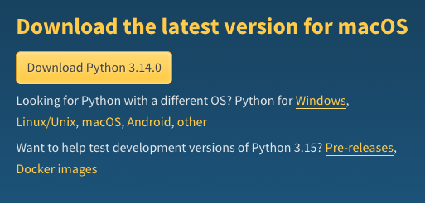

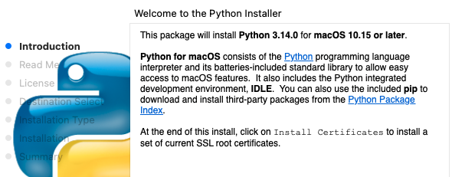

Installing & Verifying Python
Download: https://www.python.org/downloads/
→ Click Download Python 3.14.0 for macOS
2. Verify installation:
Open your Terminal and type:
1
3
2

Slide 4
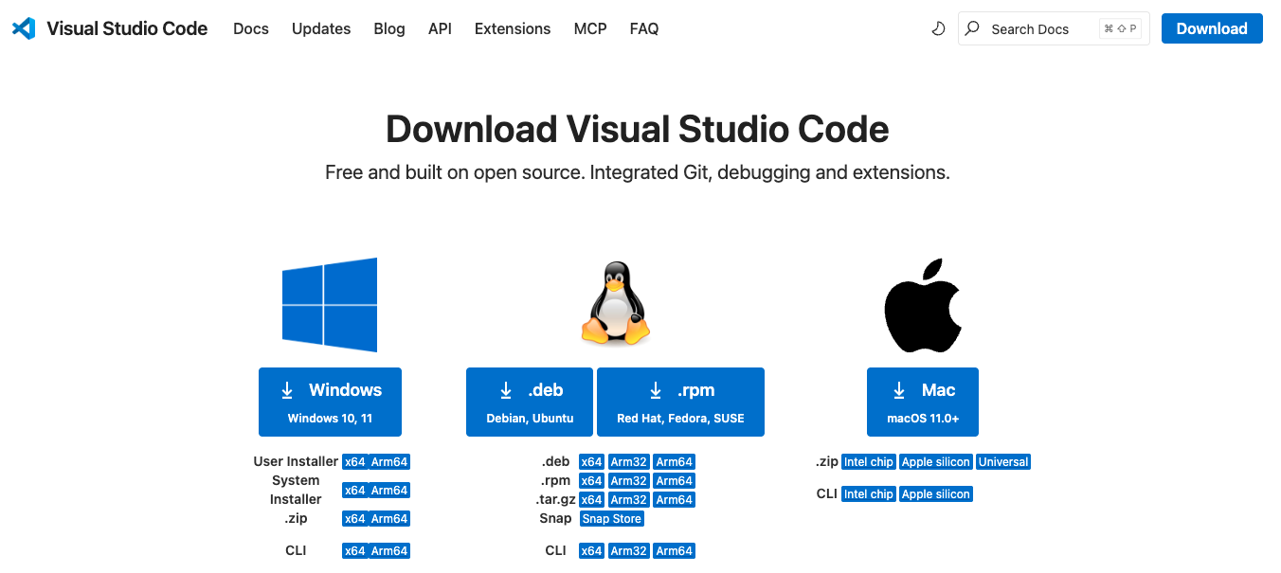
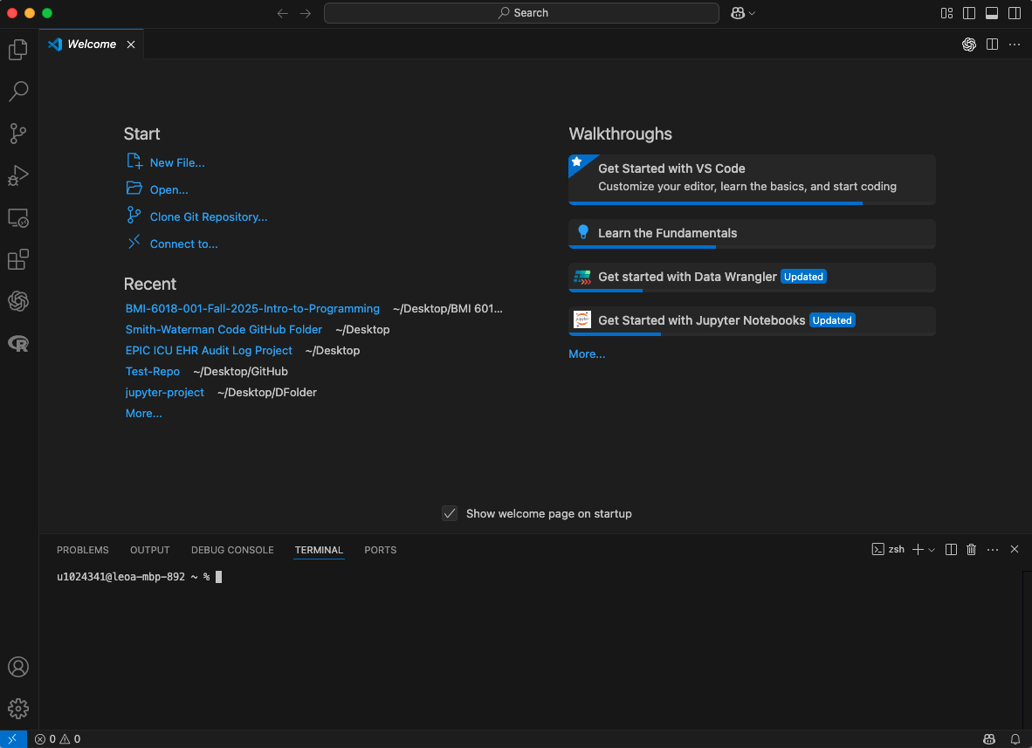


Visual Studio Code Setup
3. Download: https://code.visualstudio.com/docs/setup/mac
1
Open VS Code
3
2
Drag Visual Studio Code.app into Applications

Slide 5
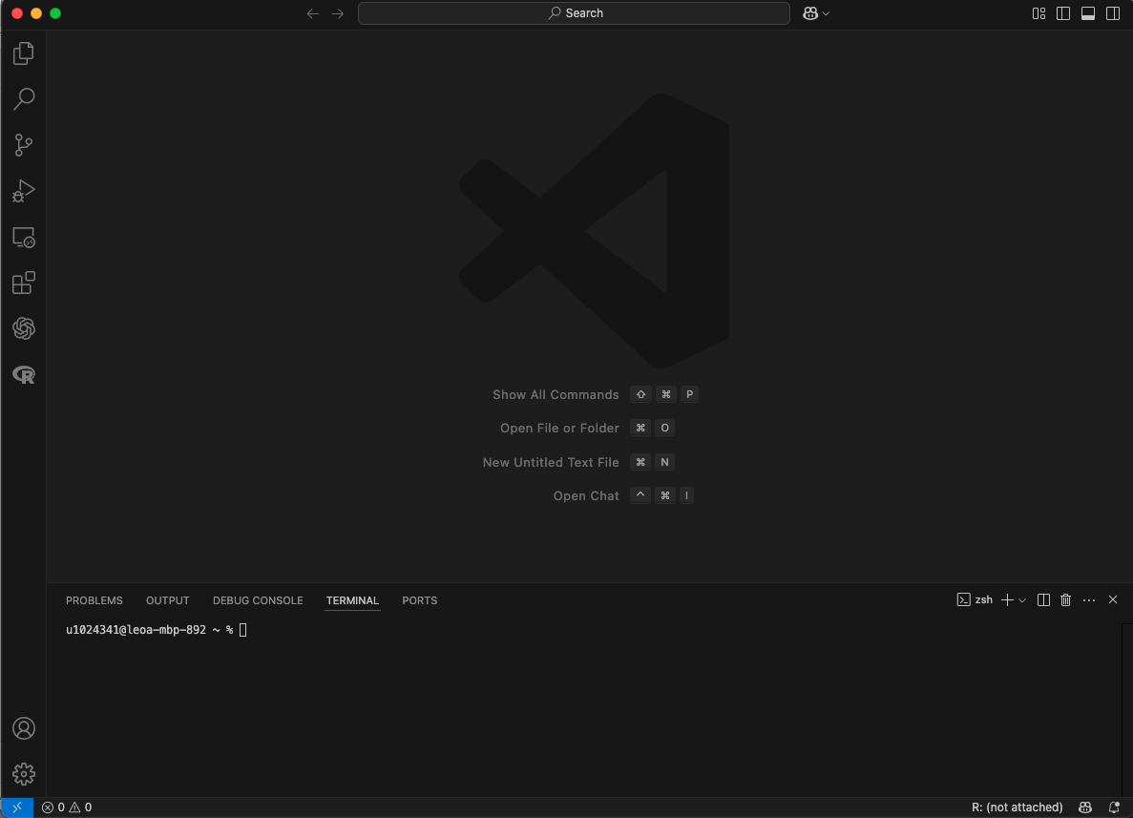
Visual Studio Code Key Features
4. Integrated Development Environment (IDE)
Explorer – Browse, open, and manage your project folders and files
Search – Search for keywords or code snippets across your entire workspace
Source Control (Git) – Track changes, commit code, and manage Git repositories
Run and Debug – Execute Python scripts or debug them step-by-step
Extensions – Browse and install helpful add-ons like Python, Jupyter, or Code Runner
Account – Manage your sign-ins and sync settings across devices
Settings – Customize themes, keyboard shortcuts, and preferences

Slide 6
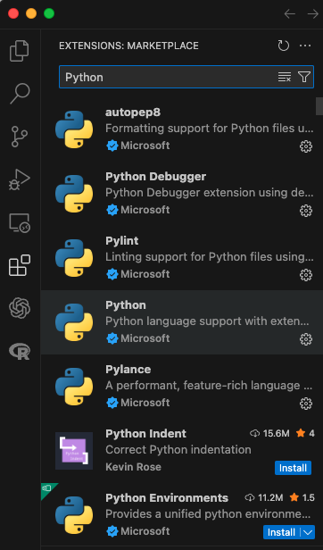
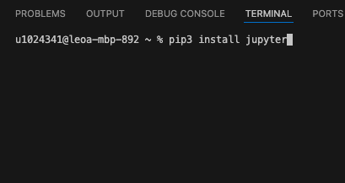
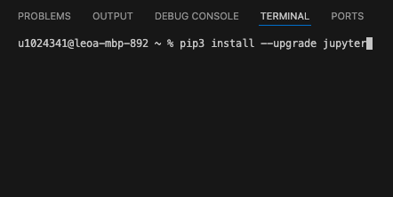
Essential VS Code Extensions & Python Packages
5. Extensions & Packages:
Python
Jupyter
Pylance
Code Runner
GitHub Copilot
NumPy
Pandas
Matplotlib
Plotly

Slide 7
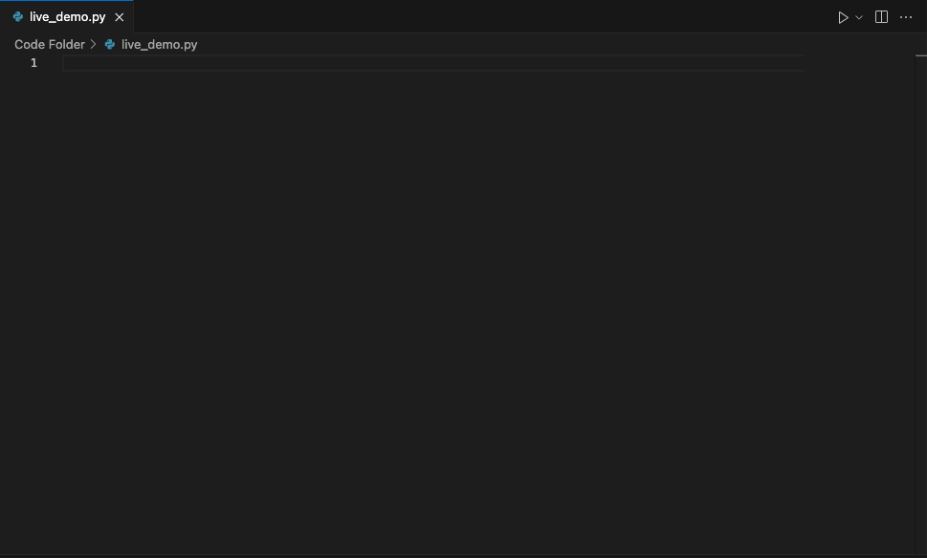
Writing & Running Python Code
6. Your First Python Script:

Slide 8
Additional Resources
https://docs.python.org/3/using/mac.html https://www.youtube.com/watch?v=nhv82tvFfkM https://docs.python.org/3/faq/
https://www.python.org/downloads/macos/

